Slide 1


Slide 2
React JS
(Create-React-App)
Lecture-14

Slide 3
Today’s Agenda
Introduction To CRA
Installation Of Node Package Manager
Creating A New Project Using Create-React-App.

Slide 4
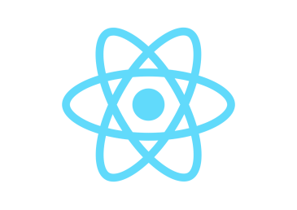

Creating A New React Project Using CRA
In the introductory lectures, we discussed the First Approach of creating a React app which was using CDN links.
From now we are shifting to the second approach of creating react project using "Create-React-App ".
The project which is created using “Create-React-App”, will :
Give us a professional set up with development web server
Remove the need of React CDN
Remove the need of any dependency like Babel
Make the browser automatically update the page whenever we make
changes in our code

Slide 5
Steps Required For Create React App
Install Node
Run the npx command for setting up the Boilerplate Application
Starting the React App Development Server
Don't worry about these all the steps in the next slide we will execute these steps in the details

Slide 6
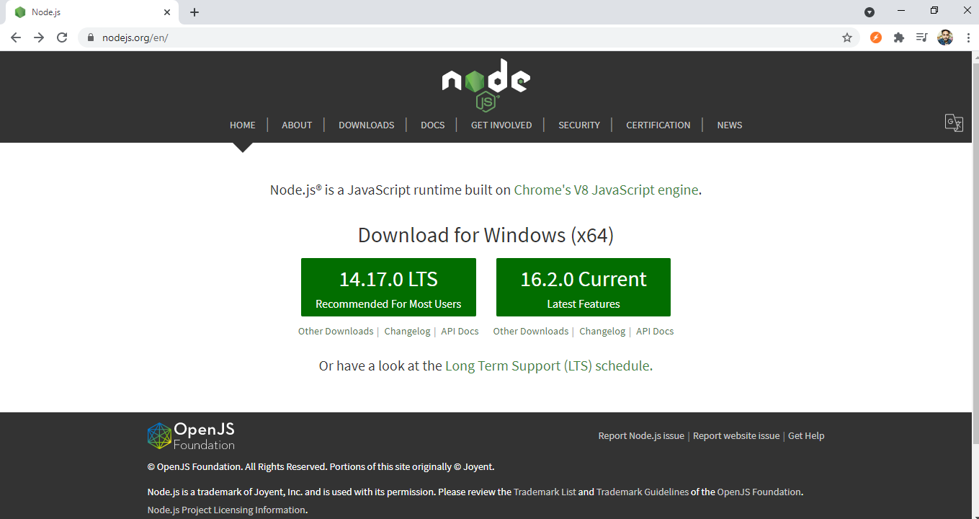
Install Node Package Manager
To install Node follow this link https://nodejs.org/en/ or visit nodejs.org.
We are downloading the LTS version

Slide 7
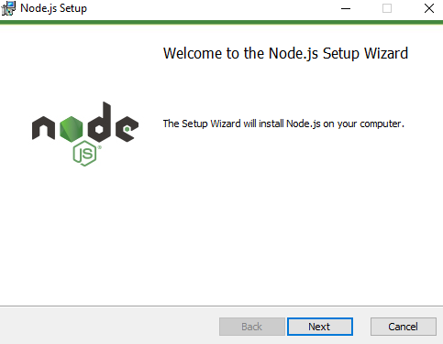
Install Node Package Manager
After download the Node setup file then run it as run as administrator

Slide 8
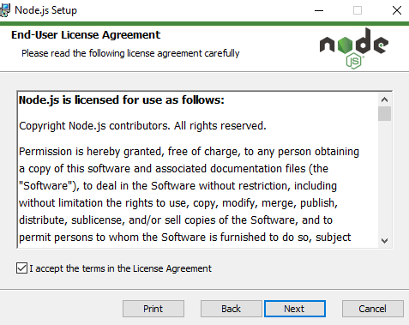
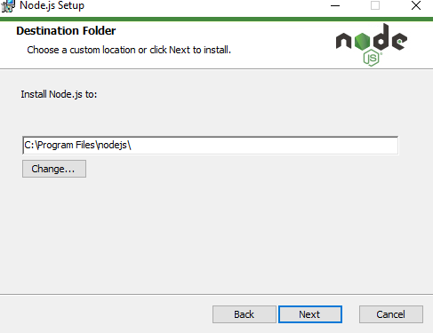
Install Node Package Manager

Slide 9
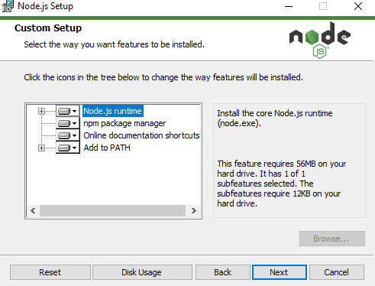
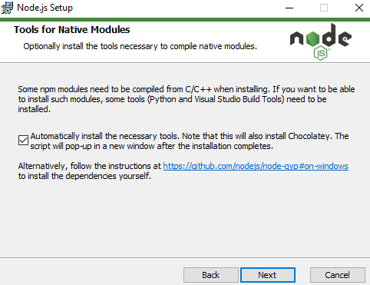
Install Node Package Manager

Slide 10
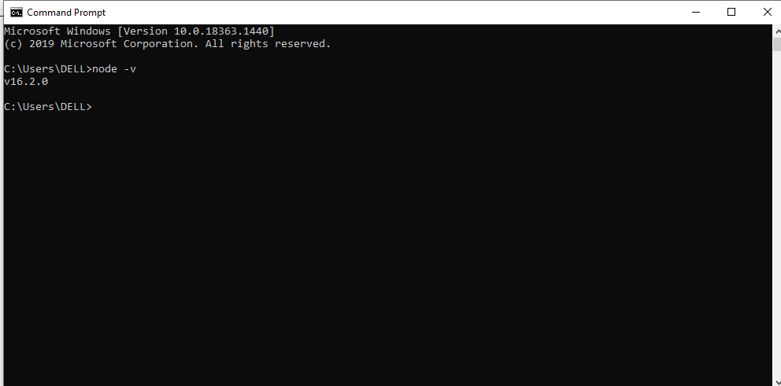
Install Node Package Manager
Now verify that node is installed successfully or not.
open command prompt with run as administrator.
Type this command
Installed Version of Node

Slide 11
Create A New React Project
Open command prompt and then navigate inside of this terminal into a folder where we want to create Our React Project.
So first we need to create a folder where we create our all react projects.
We can give any name to this folder. So, we are creating this folder by the name React Projects.
Now under this React Projects folder we will create our first react app by the name myfirstreactapp.

Slide 12
Create A New React Project
Open command prompt and then type this command:
Then it will take confirmation to install some packages.
After confirmation our new app will be created in few minutes onwards.
npx create-react-app myfirstreactapp

Slide 13
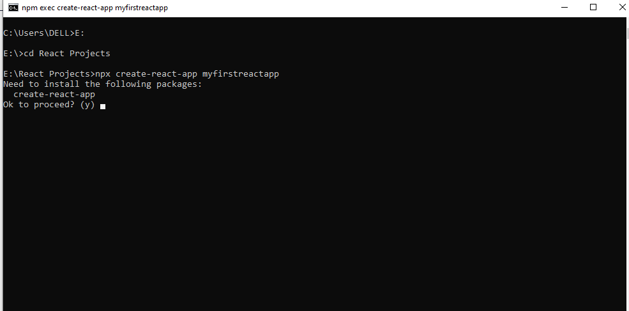
Create A New React Project
Navigate in project folder
Type y

Slide 14
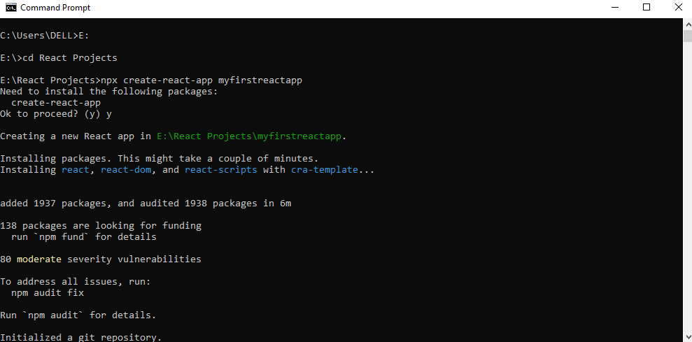
Create A New React Project
Creating new react app. it will take couple of minutes.

Slide 15
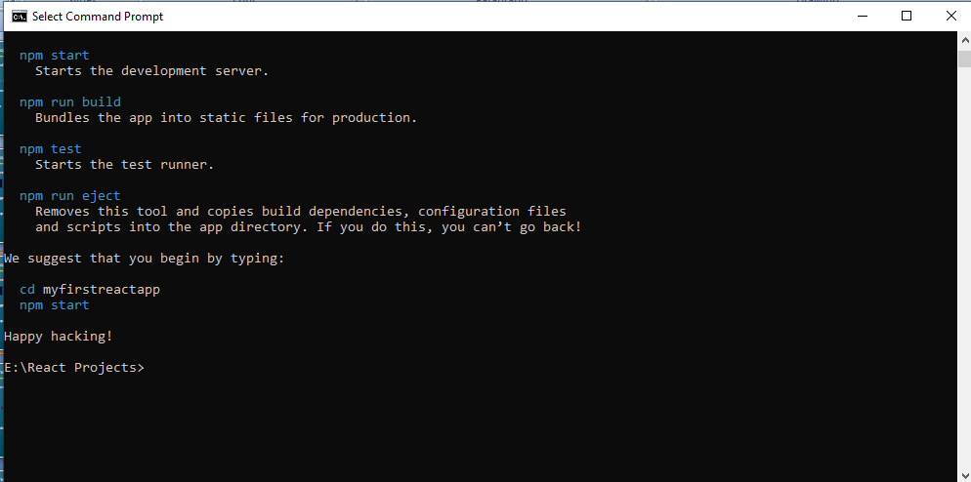
Create A New React Project
Congrats! we have successfully created our new react app.

Slide 16
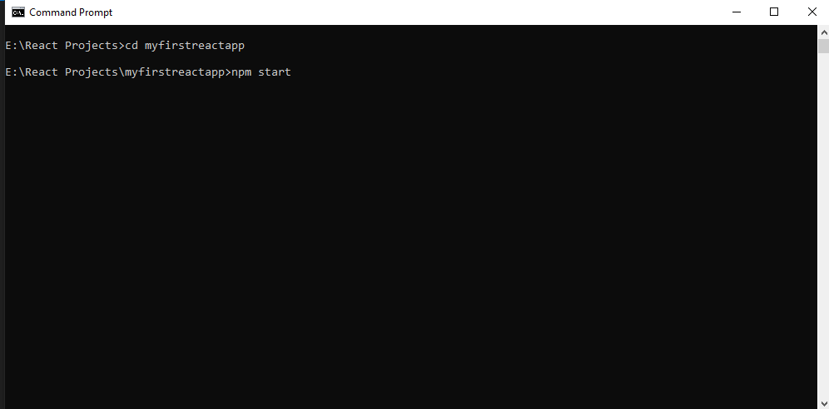
Create A New React Project
Now run “npm start” this will start the development server.
Navigate in Our newly created React app
Run this command to start development server

Slide 17
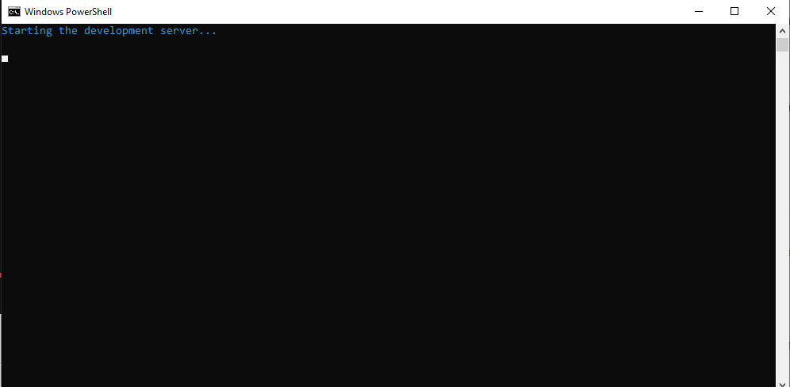
Create A New React Project
Now our development server is starting which hosts a preview of our React application.

Slide 18
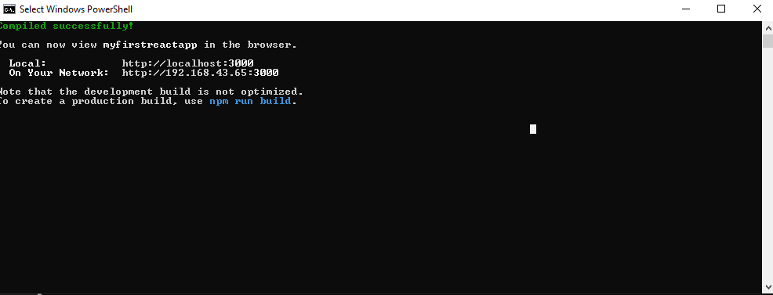
Create A New React Project
The development server is started successfully.

Slide 19
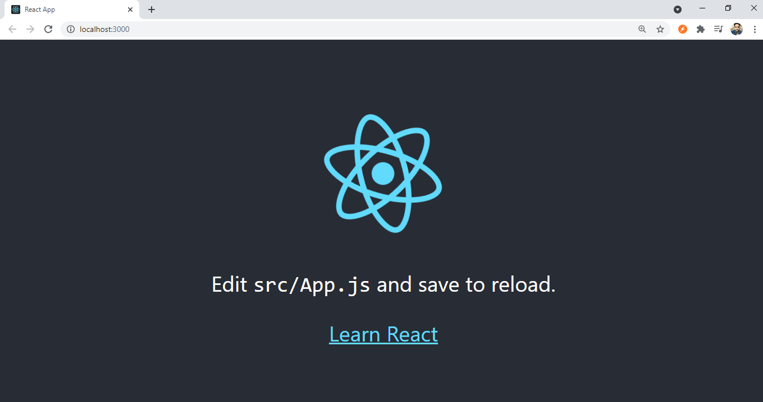
Create A New React Project
It will automatically open up this application on localhost:3000

Slide 20
Thank You

